Slide 1
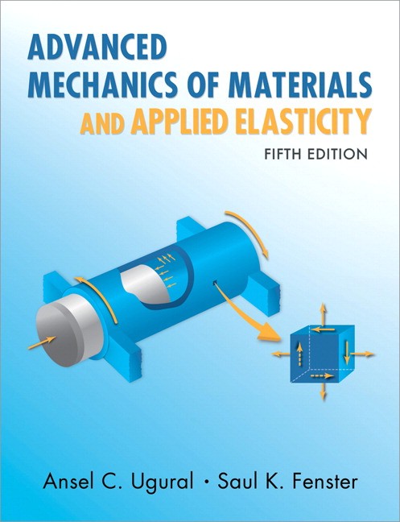
Advanced Mechanics
(Lecture 17-18)
ANNOUNCE / BUSINESS
HW 8 (due Th, 03/20)
PREVIOUS
Shear center
TODAY
Shear center
Shear flow
Torsion

Slide 2
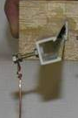
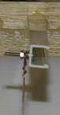
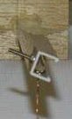
Shear Center
Point in cross section through which the line of action of a force must pass in order to generate only bending (no torsion)
(quora.com)

Slide 3
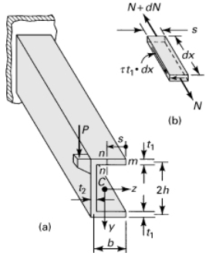
Shear Center
Independent of magnitude and direction of force
2 axes of symmetry: located at centroid
1 axis of symmetry: on axis of symmetry
May be located outside the cross section of beam
Not so important in solid or thick-walled beams since they have high resistance to torsion; more important in thin-walled beams

Slide 4
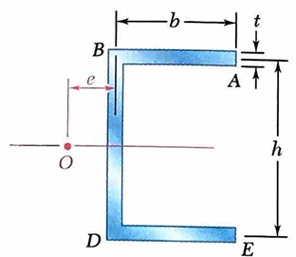
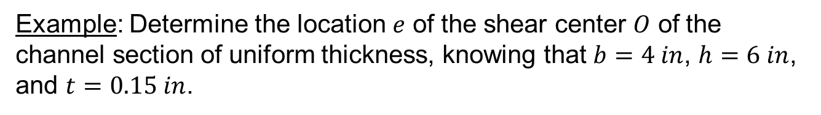
Example: Determine the location $e$ of the shear center $O$ of the channel section of uniform thickness, knowing that $b=4 in$, $h=6 in$, and $t=0.15 in$.

Slide 5
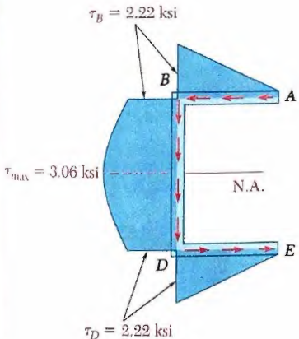
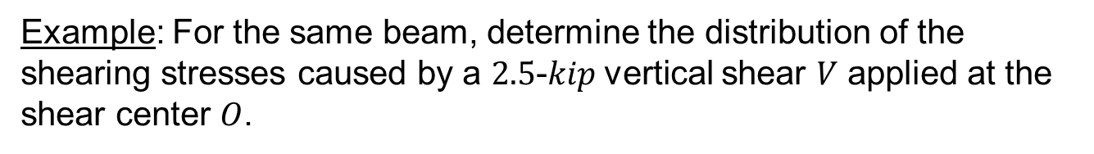
Example: For the same beam, determine the distribution of the shearing stresses caused by a $2.5$-$kip$vertical shear $V$ applied at the shear center $O$.

Slide 6
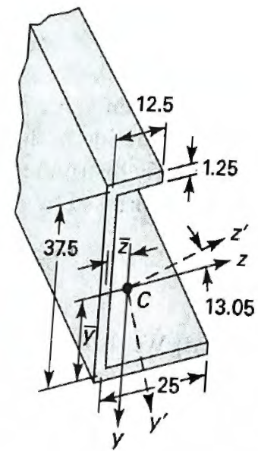
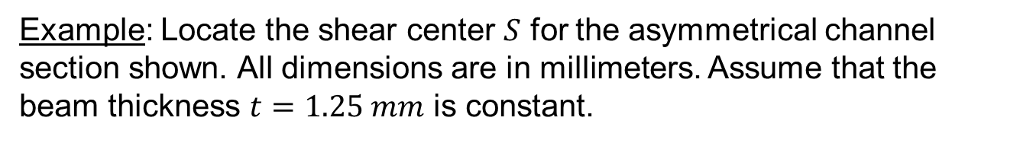
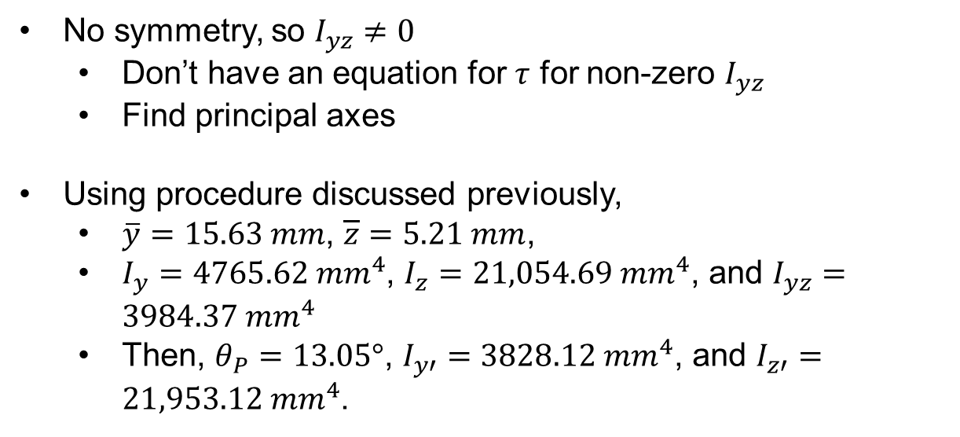
Example: Locate the shear center $S$ for the asymmetrical channel section shown. All dimensions are in millimeters. Assume that the beam thickness $t=1.25 mm$ is constant.
No symmetry, so $I_{yz}≠0$
Don’t have an equation for $τ$ for non-zero $I_{yz}$
Find principal axes
Using procedure discussed previously,
$\overline{y}=15.63 mm$, $\overline{z}=5.21 mm$,
$I_{y}=4765.62 {mm}^{4}$, $I_{z}=21,054.69 {mm}^{4}$, and $I_{yz}=3984.37 {mm}^{4}$
Then, $θ_{P}=13.05°$, $I_{y′}=3828.12{ mm}^{4}$, and $I_{z′}=21,953.12{ mm}^{4}$.

Slide 7
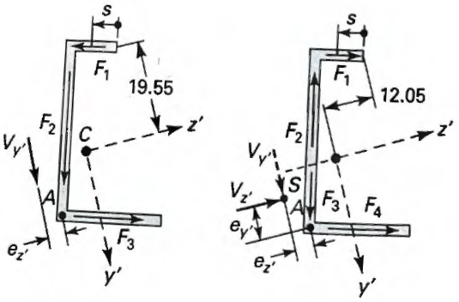

Slide 9
Torsion of Circular Cylinder
shear stress forces all points originally lined up to remain so

Slide 10
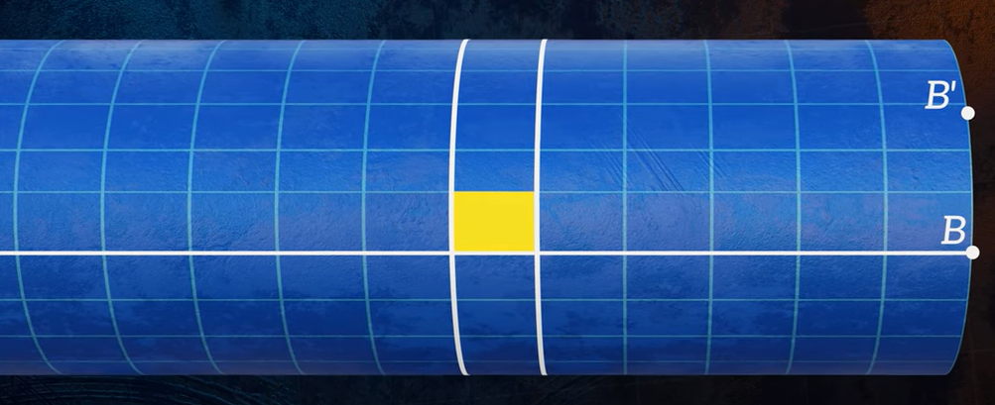
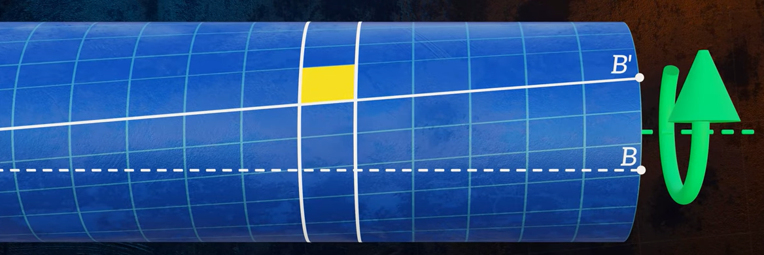
(The Efficient Engineer – YouTube)

Slide 11
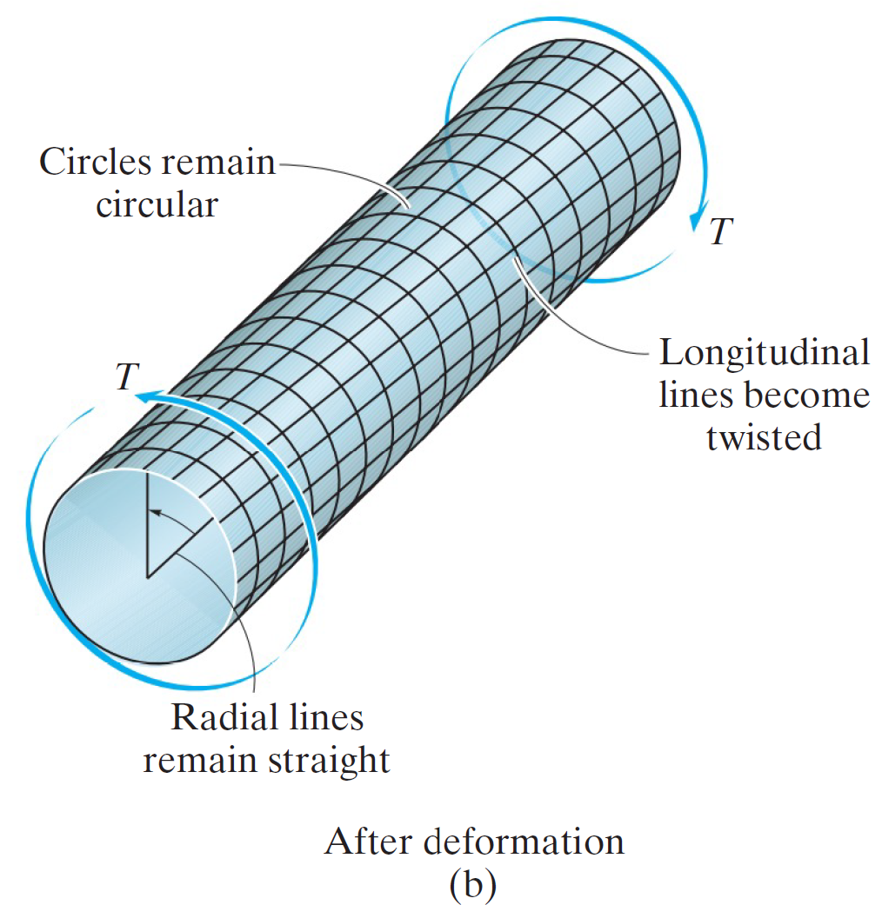
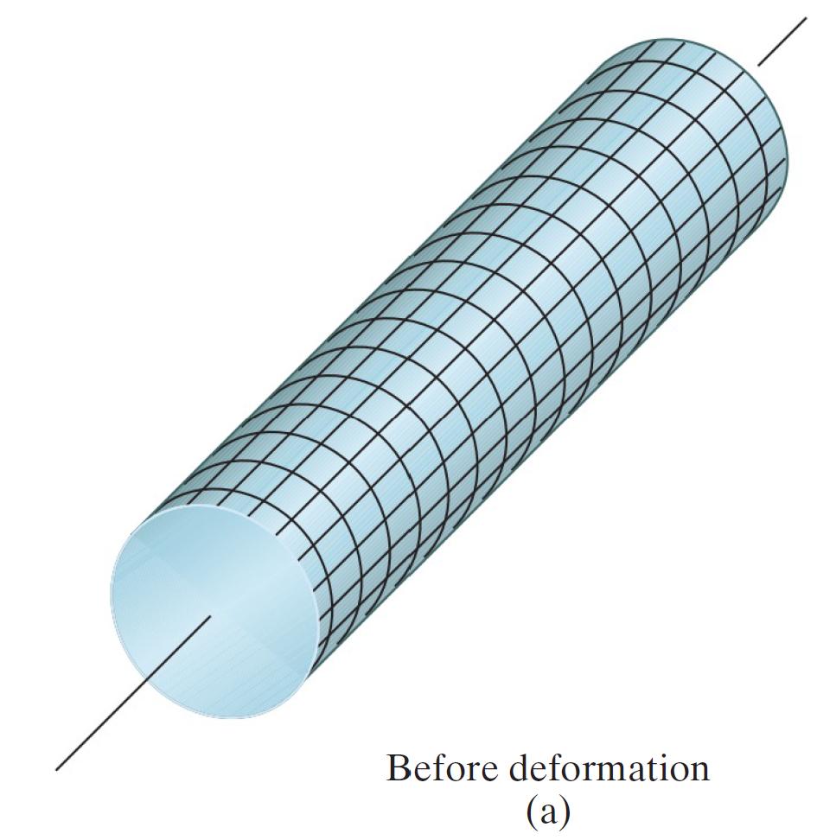
Torsion
Plane sections remain plane and undistorted

Slide 12
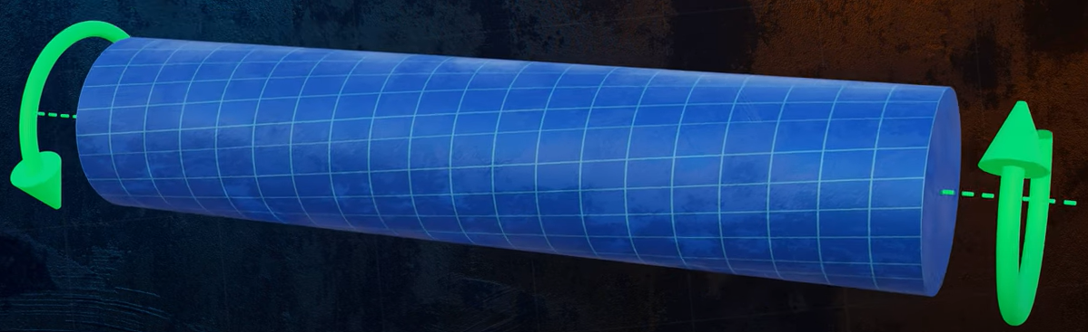
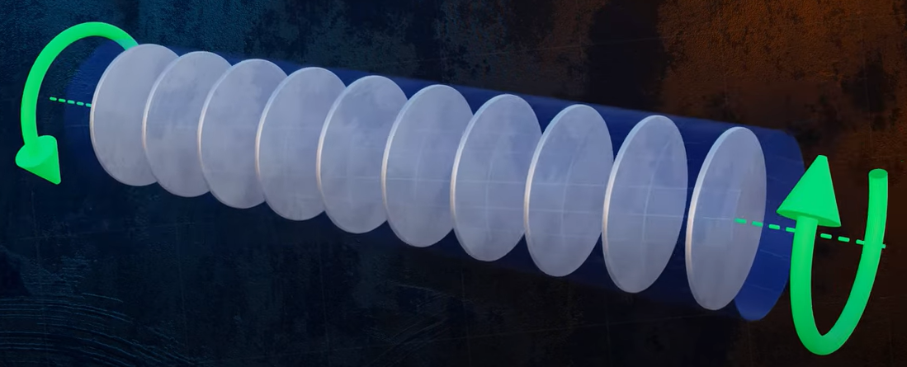
(The Efficient Engineer – YouTube)
Plane sections do not remain plane for non-circular cross-sections!

Slide 13
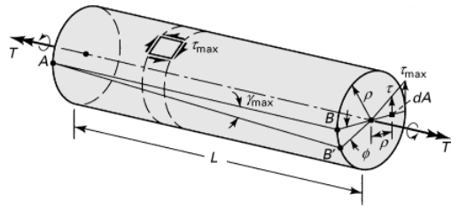
Assumptions
Assumptions:
Linear elastic
Homogeneous
Plane sections remains plane

Slide 14
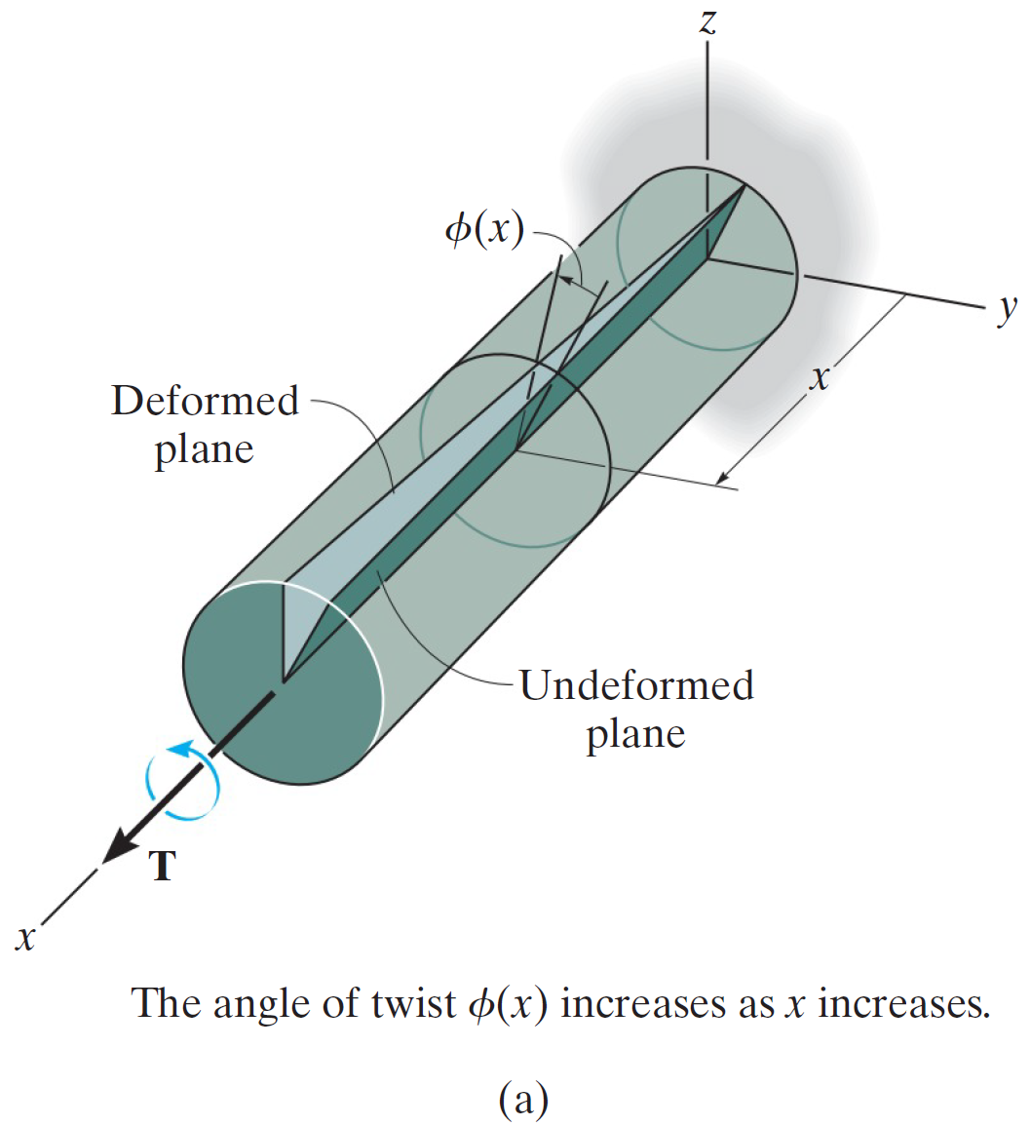
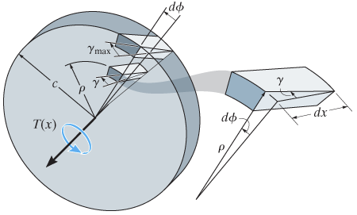

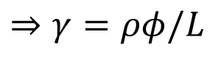
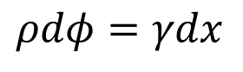
Shear Strain
$$ρdφ=γdx$$
$$⇒γ=ρφ/L$$
* Note that there is no shear strain in the $y$-$z$ plane.

